Slide 1

ActionSense Final Presentation – Extracting Action Items from Unstructured & Noisy Meeting Data
Large Language Models and its Applications
Meir Weinberg & Yael Reina

Slide 2

Review and project definition
The problem
The "Hebrew-English" Gap: . State-of-the-Art models excel in formal English but cannot accurately extract action items when team members switch languages mid-sentence.
Cultural Context: The informal nature of Israeli high-tech meetings creates "noise" (slang and rapid language shifts ) that confuses standard LLMs, resulting in missed tasks and fabricated deadlines.
Our Goal
Data: Creation of the synthetic dataset for Hebrew-English organizational dialogue
Automated Action: Developing a robust pipeline for extracting structured Action Items (Who, What, When) from noisy and bi-lingual Israeli high-tech meetings

Slide 3
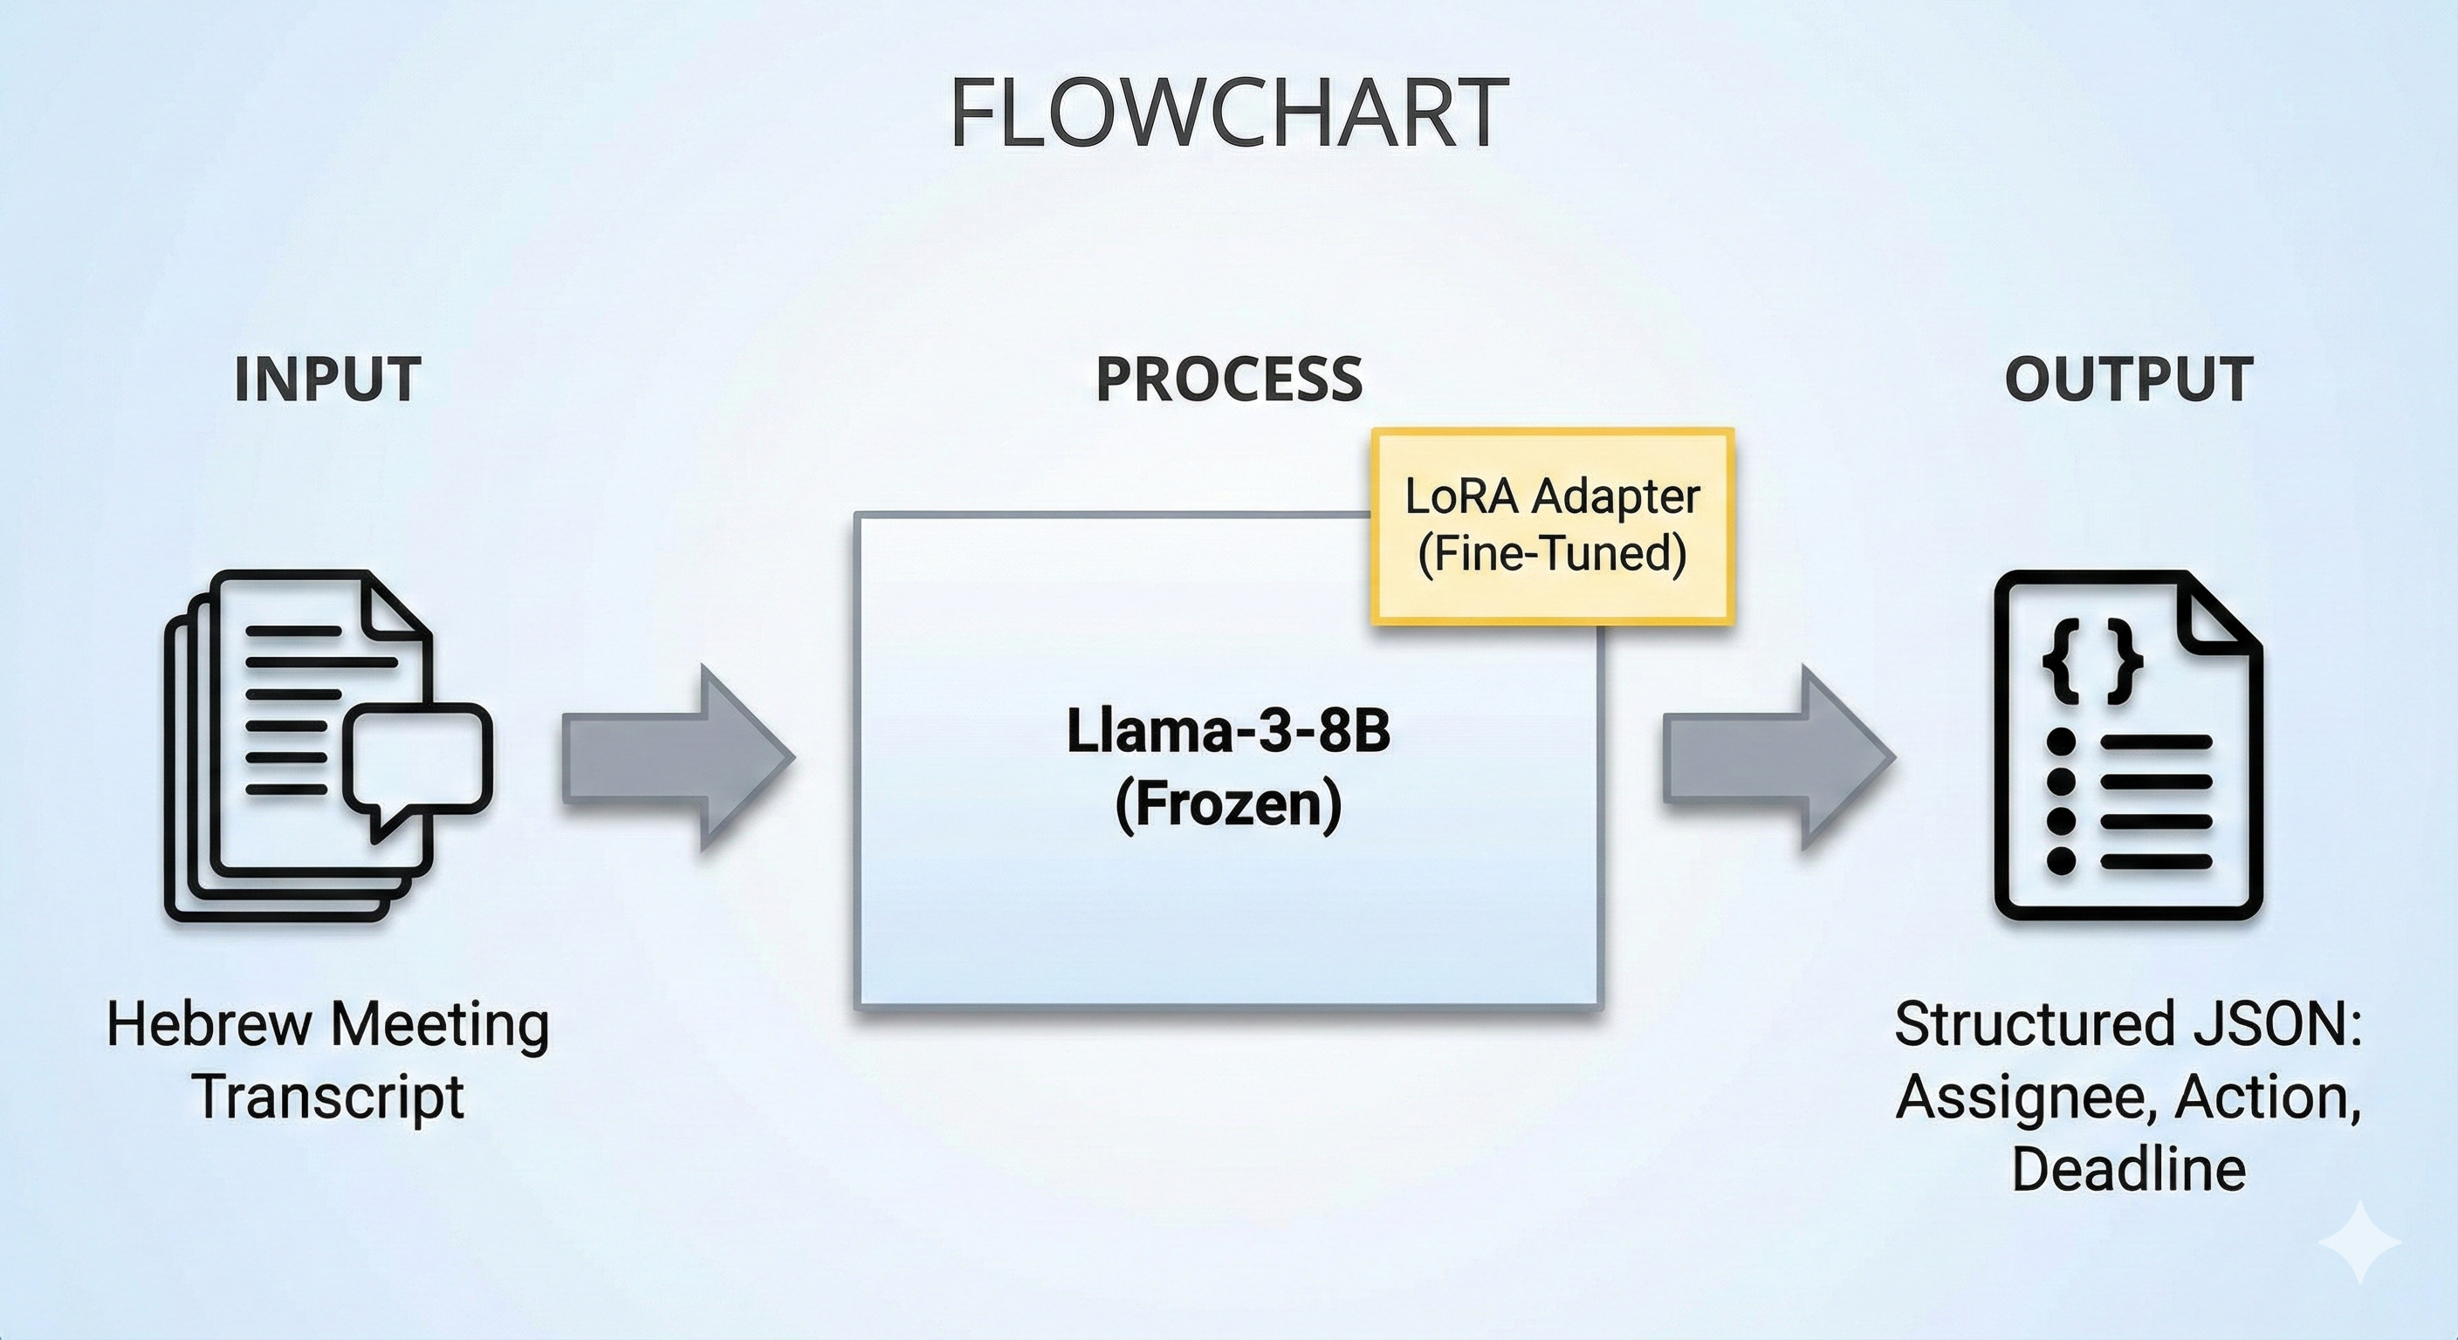

Slide 4
Project achievements and novelty
What we achieved?
Data:
Novel Data Source: Developed a unique dataset tailored to the linguistic patterns of Israeli tech hubs
Data quality: 230 High-quality synthetic Data Generation using LLMs
Model and Evaluation:
From 1% to ~60%: Successfully fine-tuned llama-3-8b-bnb-4bit model to become a specialized task extractor
Robust Evaluation Pipeline: a custom pipeline using the Hungarian Algorithm for list matching and AlephBERT for semantic similarity in Hebrew.

Slide 5

Data
methodology
Data preparation:
We created the dataset using the following steps:
creating a Task Bank from the AMI dataset
translating the Task bank to “Hibrish” using gpt-3.5-turbo
Generating synthetic Israeli high-tech meetings using the tasks from the Task bank using gpt-4o
The result:
A synthetic dataset containing 230 high-tech meeting with : 15–50 lines and 1-4 tasks and High presence of temporal expressions for deadlines (e.g., "End of the week," "By the 15th")

Slide 6
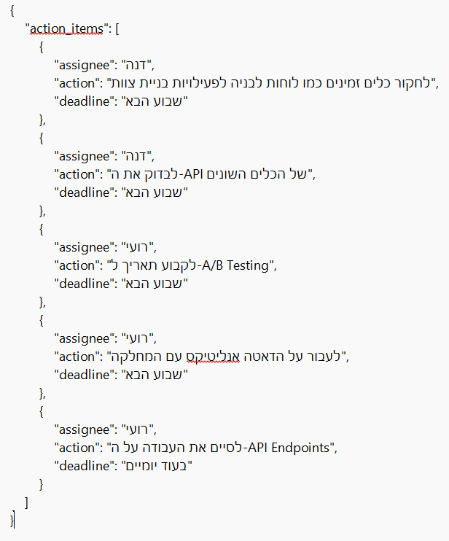
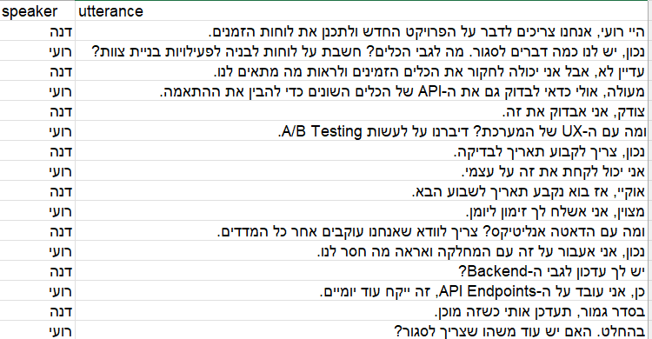
Data Example
The order of the tasks in the JSON files is the same order of the tasks in the meetings

Slide 7
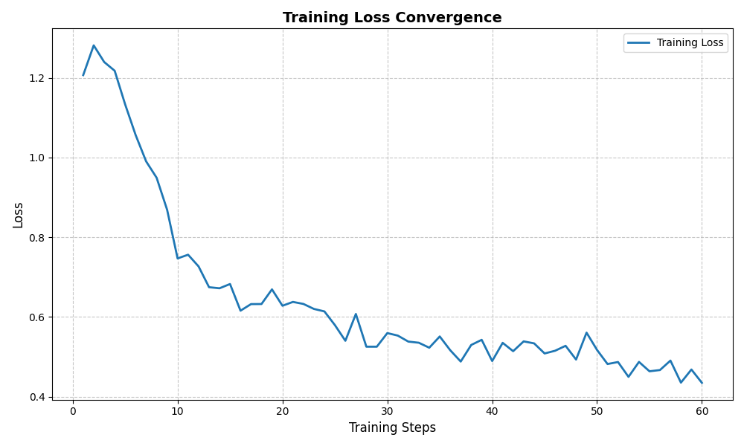
methodology
Training
Model & Training
Base: llama-3-8b-bnb-4bit (Quantized).
Technique: LoRA, dropout, learning rate, "Train-as-you-test" prompt strategy.

Slide 8

methodology
Evaluation
Evaluation Metrics (The Challenge):
Since the order of items matter, we used Hungarian Algo to match predicted tasks to ground truth, temperature for determinism
Assignee: Fuzzy Matching (Ratio > 80).
Action: Semantic Similarity using AlephBERT embeddings.
Deadline: Soft string matching (Ratio > 85).

Slide 9

Results
Results: dramatic Improvement over Baseline
Quantitative Results:
Baseline (Zero-Shot): FAILED (~1% Accuracy). Output was unstructured text/English.
Baseline (One-Shot): ~11.5%. Improved structure but struggled with Hebrew content.
Fine-Tuned:
Assignee: 56.7% (High precision in entity extraction).
Action: 59.3% (Strong semantic understanding).
Deadline: 35.1% (Challenging due to relative dates like "next week").

Slide 10
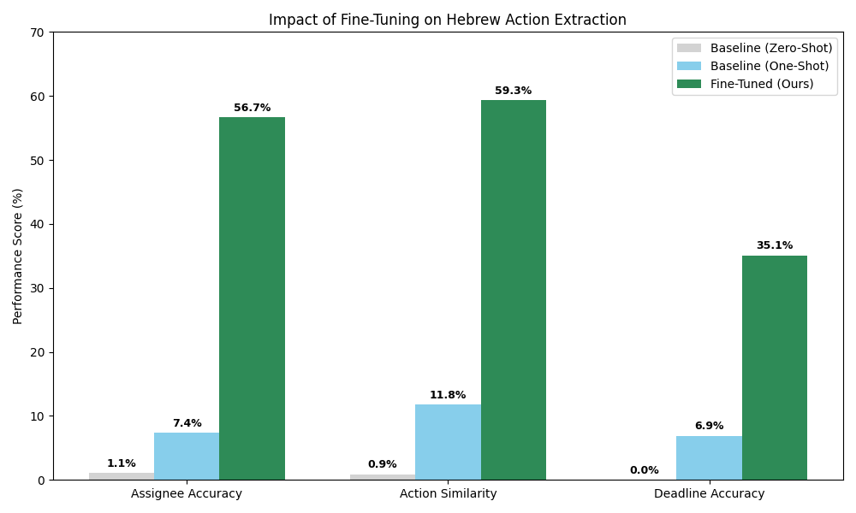
Results

Slide 11
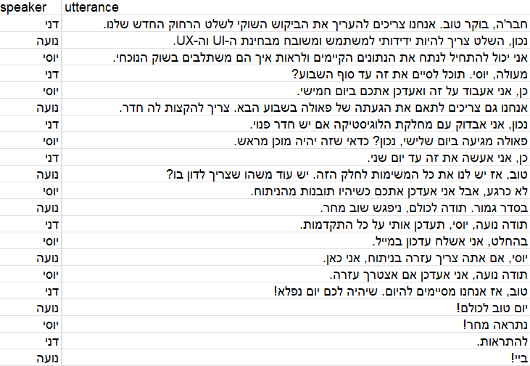

Slide 12
 | Expected
 | Baseline zero-shot
 | Baseline one-shot
 | After Fine-tuning

Slide 13

Conclusion & Future Work
Did we achieve the goal?
Yes. We transformed a model that couldn't handle the task into a reliable extractor for Hebrew action items.
Lessons Learned:
"Train as you test": Consistency between training prompts and inference prompts is critical.
Metric Design: Evaluating generative lists requires semantic matching algorithms, not just string comparison.
Future Work:
Dataset Expansion: 230 samples is small. Increasing to 1000+ would likely solve the Deadline accuracy issues.
Date Normalization: Integrating a dedicated date-parser to convert "next Sunday" to YYYY-MM-DD.

